Slide 1
Welcome! 12 Biblical Principles for Relationships for the Incarcerated and Correctional Officers
Workshop

Slide 2
Why Prison Ministry??
There are 2.2 million men and women prison inmates in the US
2/3 of released inmates will return to prison within 3 years
"Prison Ministry is The Most Fruitful Mission Field in Our Country" - Lennie Spitale, author of the book, "Prison Ministry“
Heb.13:3 “Remember the prisoners…
Notes:
yellow

Slide 3
“Helping inmates reach inmates!”

Slide 4
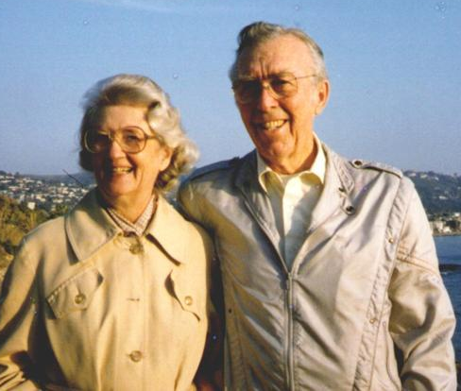
How Prison Mission Association started:
In 1955, Joe Mason in
Texas developed Bible
studies to help new
Christians become
grounded in the scriptures. The result was the establishment of PMA, formed with the goal of ”Reaching prisoners for Christ” and helping them study and apply God’s Word.
Joe and Ada Mason

Slide 5
PMA has 33,000 students in USA
When our student completes all 35 lessons they may earn 6 credit hours from Berean Bible Institute, Slinger, WI.
This sets us apart from other prison ministries as we build an ongoing relationship, helping them to grow in their walk with God, with indepth Bible Study.

Slide 6
“Vision 2025 ”
Prison Mission Association provides Bible Correspondence courses at no cost to inmates in all 50 states with the goal of reaching prisoners for Christ, developing Godly leadership and planting Grace churches in prisons.
Notes:
green

Slide 7
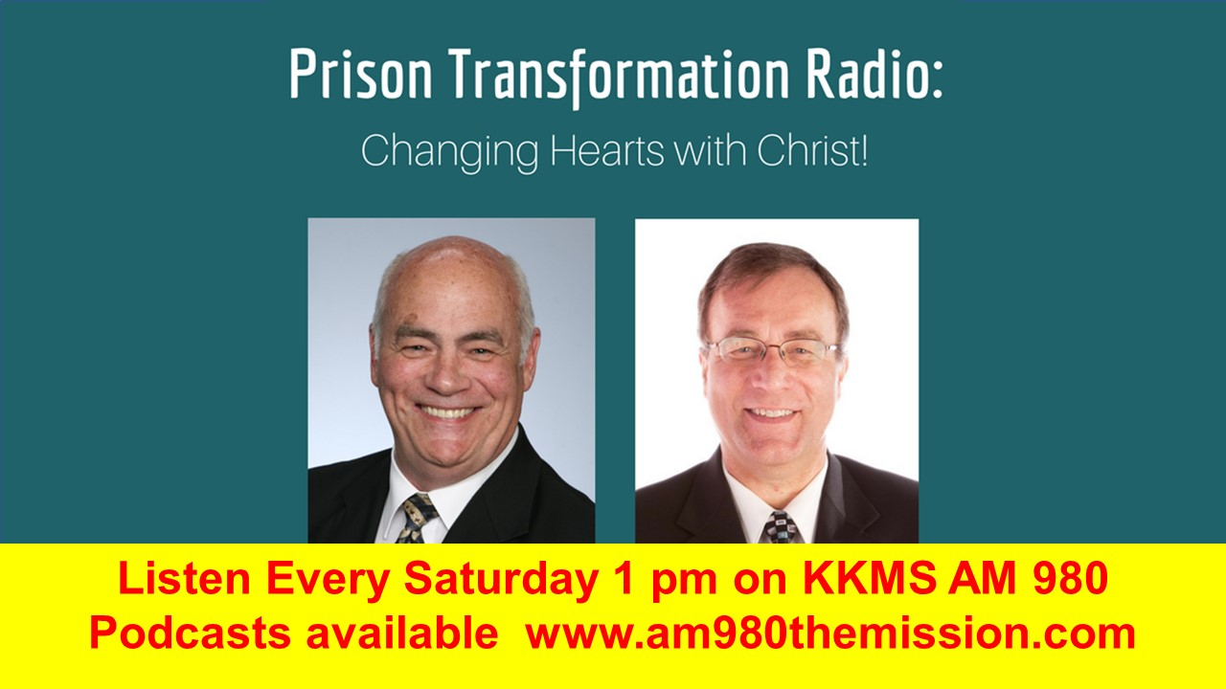
God has opened a door to share what God is doing behind bars with a weekly radio show:

Slide 8
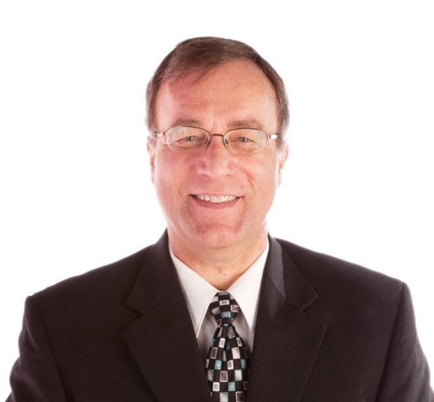
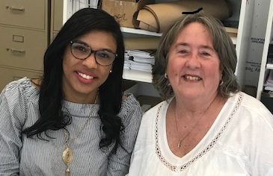
Please PRAY for Our Team
Alta Soriano
Spanish
Ministry
Washington
Dwight Anderson
Executive
Director
Minnesota
Karen Bodeutsch
Operations Manager
Washington

Slide 9
Pray for the Dwight Anderson Family
Dwight is blessed to be married to Darlene for 37 years!

Slide 10
Overview of Workshop:
Explain the need to reach not only inmates but correctional officers (CO)
Share this workshop for inmates and CO with you that you will be able to offer it to your local prison
Resources of the 12 seeds book and journal workbook for this course.
Action Steps

Slide 11
Why the need to offer help to Correctional Officers?
Example of Apostle Paul. Phil 1:12-13
¹² Now I want you to know, brothers and sisters, that what has happened to me has actually served to advance the gospel. ¹³ As a result, it has become clear throughout the whole palace guard and to everyone else that I am in chains for Christ. ¹⁴ And because of my chains, most of the brothers and sisters have become confident in the Lord and dare all the more to proclaim the gospel without fear.

Slide 12
Why the need to offer help to Correctional Officers?
Example of Apostle Paul. Phil 1:12-13
While in prison, he shared the gospel not just with inmates but reached the whole palace guard

Slide 13
Why the need to offer help to Correctional Officers?
Extremely high stress job
They are getting attacked more
i.e, MN several murdered in 2018.
20% higher divorce rate
39% higher suicide rate
10 times higher PTSD Rates
50% Higher Heart disease
May 21, 2018 https://armorupnow.org/2018/05/21/ptsd-depression-suicide-divorce-are-highest-among-correctional-officers/

Slide 14
Correctional Officer Among the Top Ten Most Dangerous Jobs
Inmates have a higher-than-average rate of deadly diseases like Hepatitis C, the HIV virus that causes AIDS, tuberculosis (TB), and MRSA (Methicillin Resistant Staphylococcus Aureus).
Inmates also typically have high rates of STDs (Sexually Transmitted Diseases), in the event that guards are sexually assaulted

Slide 15
Correctional officers also face:
Drug addicts coming off a high.
The risk of being injured during a body or cell search.
The risk of being blindsided by an angry inmate.
The risks associated with transporting inmates.
Attacks with handmade prison weapons.
Attacks with the bare hands of inmates.
Imagine going to work and almost everyone hates you and would like to hurt you to escape.

Slide 16
Other facts on Correctional Officers
33.5% of all assaults in prisons and jails are committed by inmates against staff.
A CO's 58th birthday, on average, is their last.
A CO will be seriously assaulted at least twice in a 20 year career.
On average a CO will live only 18 months after retirement.
http://www.corrections.com/news/article/30096-beating-the-odds

Slide 18
12 Seeds for Successful Relationships
POOR RELATIONSHIPS = many costs, much pain
GOOD RELATIONSHIPS = many benefits much joy!
Everyone can improve their relationships!
www.12seeds.com for books and resources

Slide 25
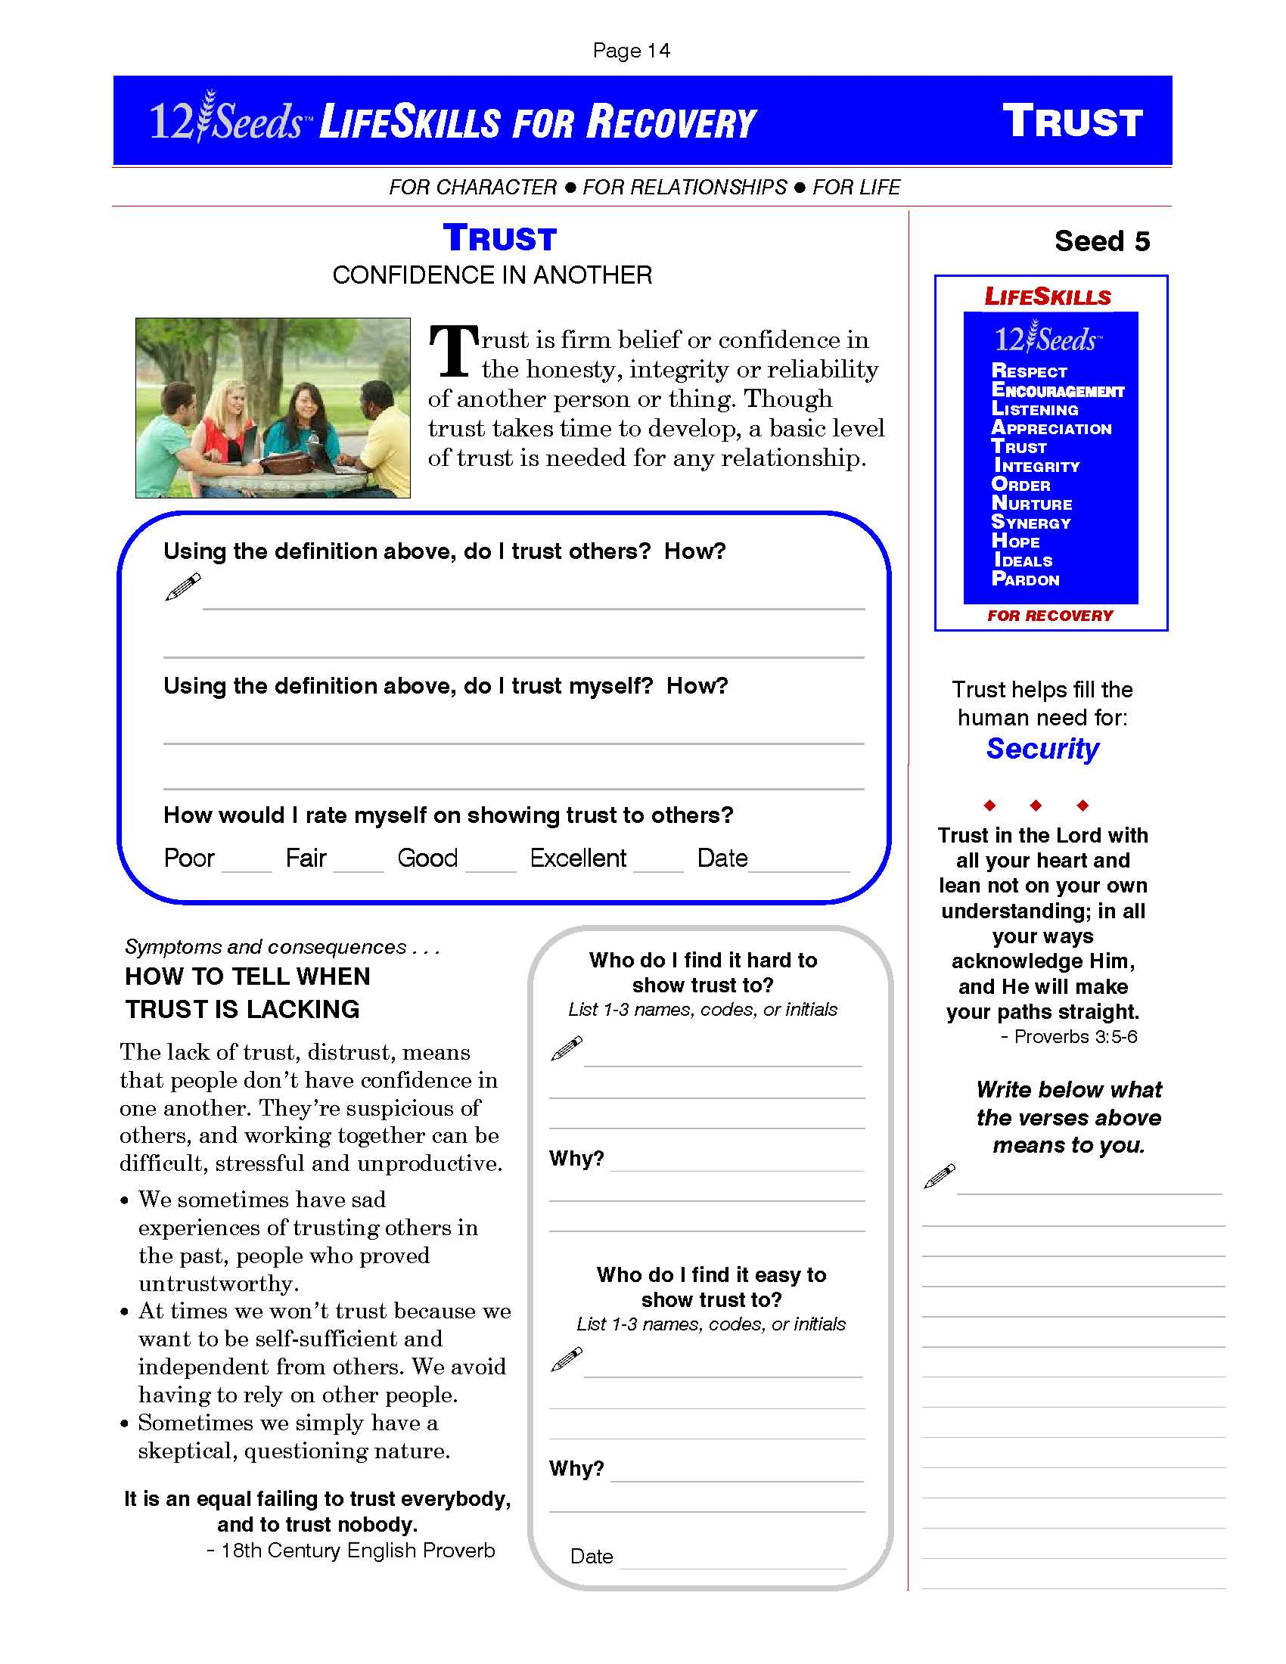

Slide 26
Action Steps:
1. Pray for the inmates and correctional officers near you. Ask God to open a door to reach out.
2. Contact your local prison and ask permission to teach this to inmates and correction officers
3. Organize your church to run a 12 Seeds workshop and give out PMA lessons.
4. Volunteer your time and money to be a blessing in this fertile harvest field!

Slide 27
Action Steps:
5. Pray for God to move in hearts for this ministry and join us as partners in prayer, finances and representatives.
6. Pray for your local jails and prisons. Seek God’s will as you are the ambassador to reach those near YOU!!!
7. Contact Pastor Dwight for more info
612-423-3457 dwight@prisonmission.org

Slide 28
Questions? Feedback?

Slide 29
Thank you!!
Thanks for serving the Lord to help reach inmates and others to know the Gospel of the Grace of God!!
Contact me for more info:
Pastor Dwight Anderson, 612-423-3457
dwight@prisonmission.org
www.prisonmission.org

Slide 30
Visit our display or website
to learn more!
www.prisonmission.org

