Slide 1
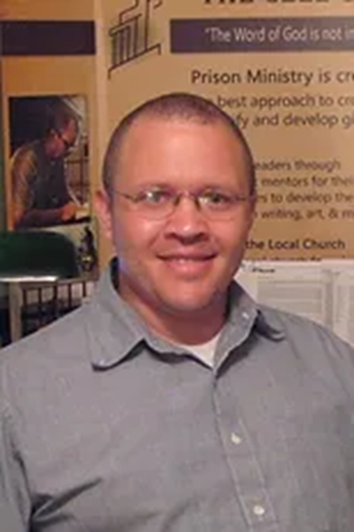
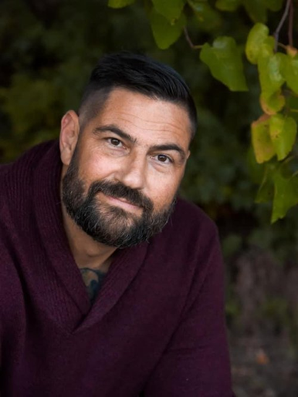
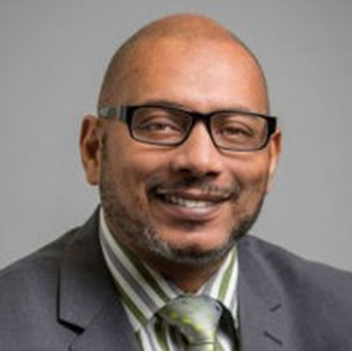
Strengthening the Indigenous Church in Prison
Mark Walker
The Cell Church
Matt Thomas
Firm Foundations
Charles Anderson
Epiphany Life Change

Slide 2
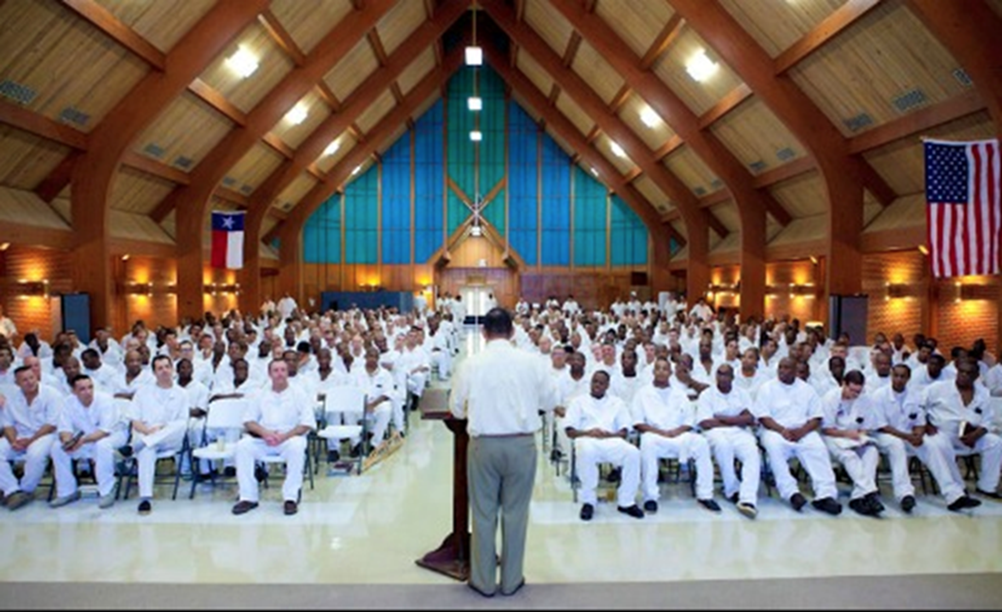
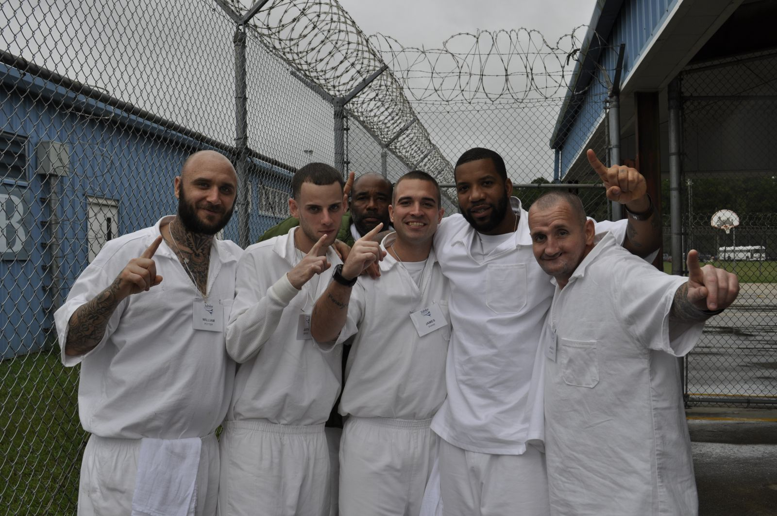
One of most exciting developments in Kingdom coming from America’s prisons
For decades, God’s people sowing seeds among incarcerated

Slide 3
God’s people sowing seeds among incarcerated
Fruit is cropping up all over

Slide 4
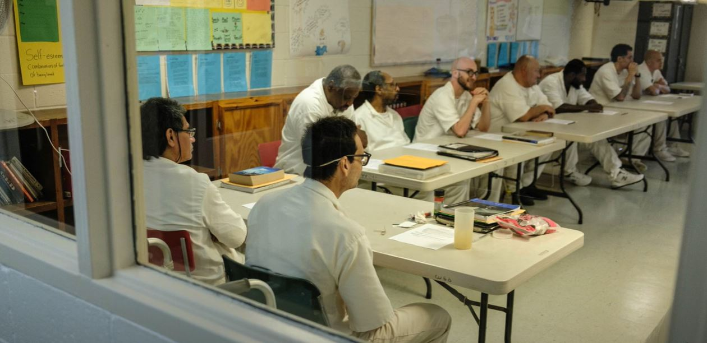
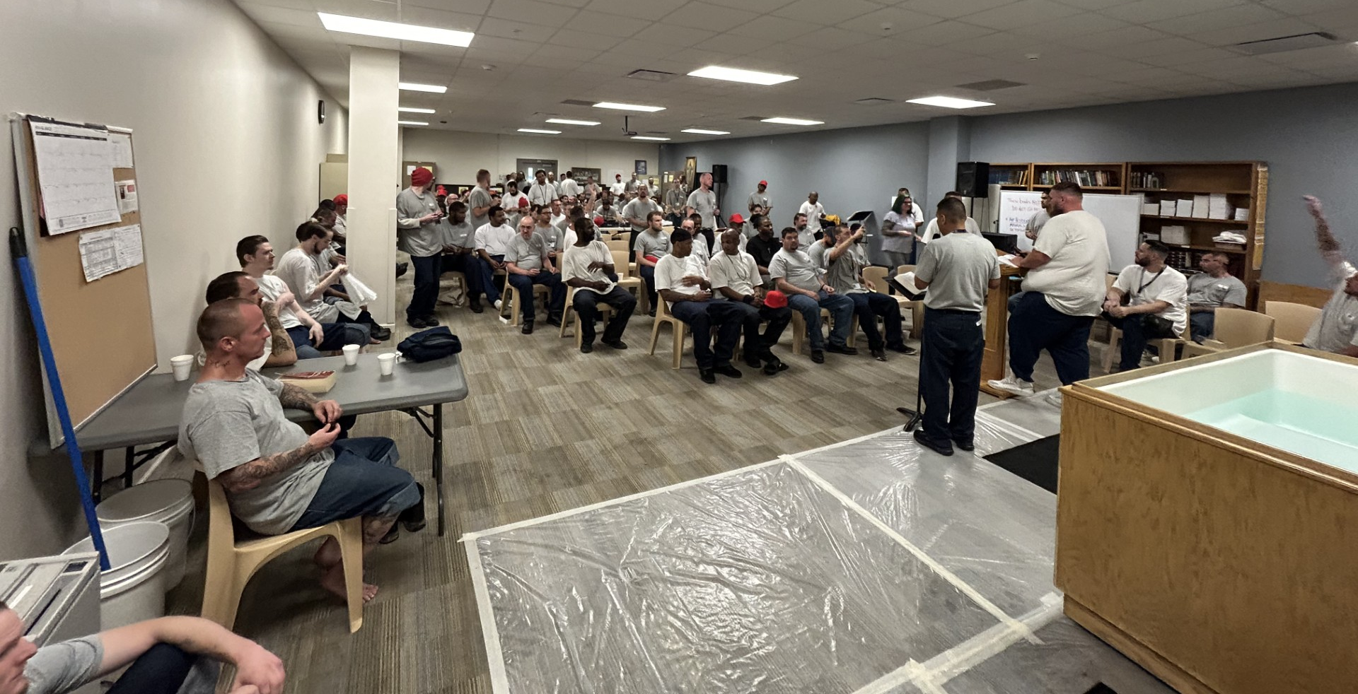
Thousands discipling
fellow prisoners

Slide 5
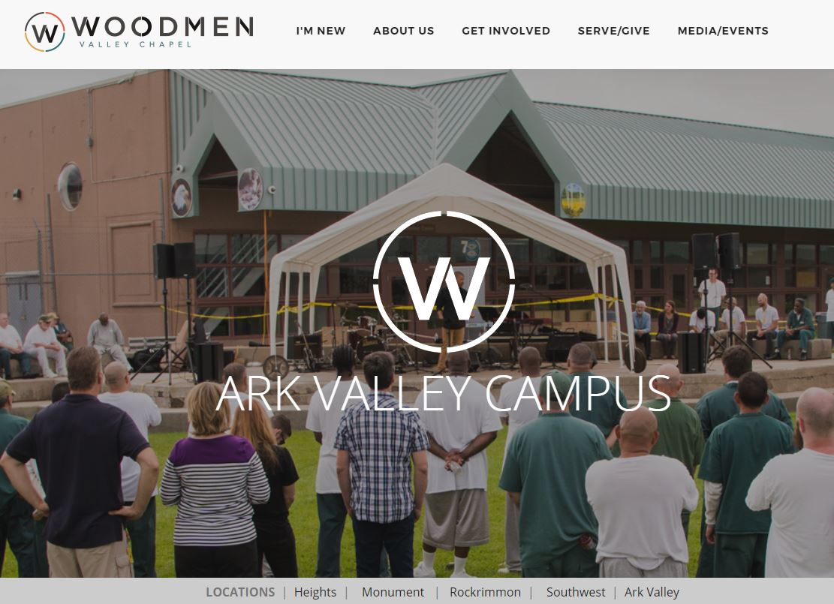
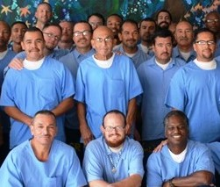
Not every person reached,
but no longer dependent

Slide 6
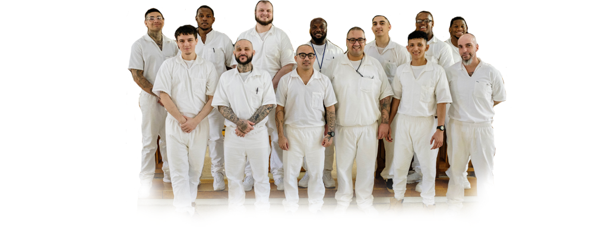
For long time “Unreached Mission Field”
Now “Indigenous Church”

Slide 7
Mark Walker CMCA 2023
Prison Ministry as Cross-Cultural Mission
https://vimeo.com/831975408/8fcf4152df
Prison has its own distinct culture (“unspoken rules of expected behavior”) – Thailand, Nigeria, U.S. prisons
Those who live in and initially shaped by the culture are indigenous to that culture (indigenous vs. relocating to Peru)
We now have mature, indigenous disciple-makers in prison culture who are essentially leading the Church on the inside
Prison culture + indigenous disciplemakers = Indigenous Church in Prison

Slide 8
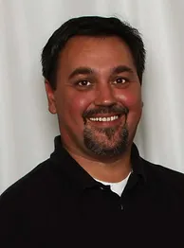
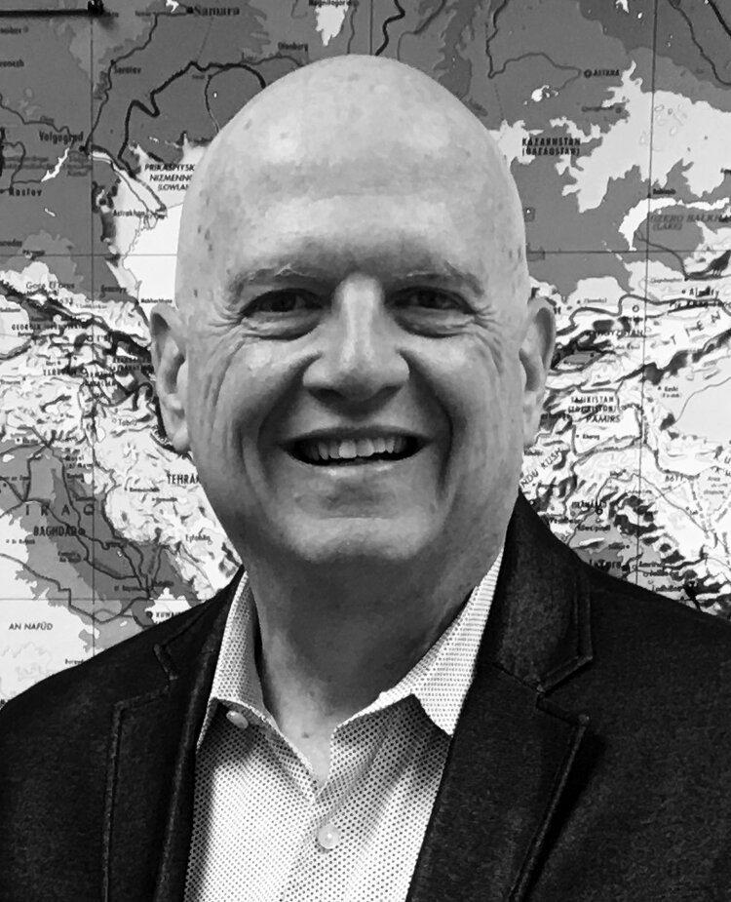
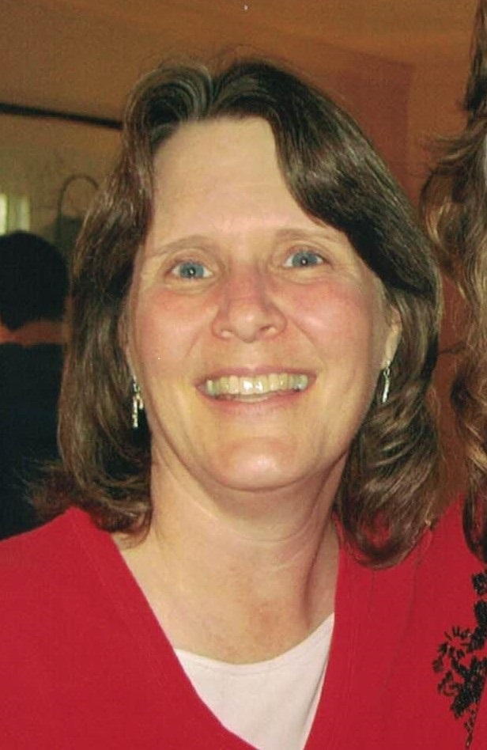
Friends forming:
-Learning community
-Think tank
-Support group

Slide 9
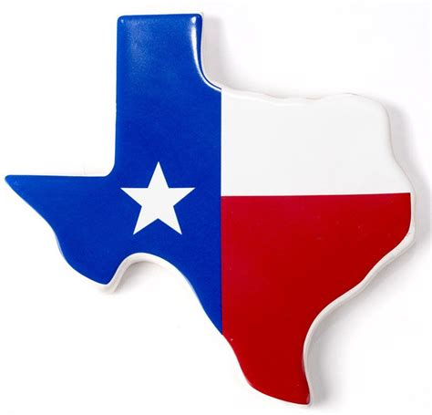
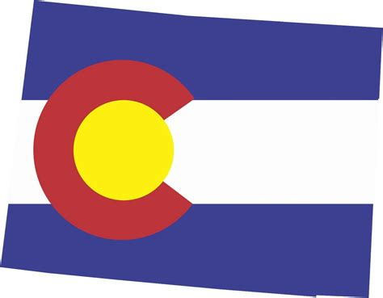
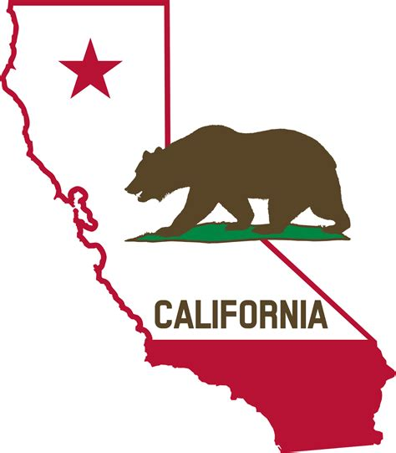
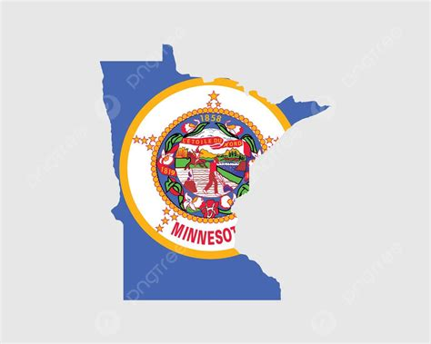
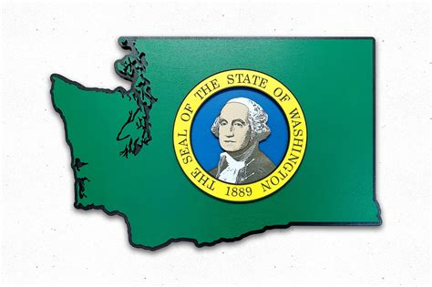
Passion to empowering disciple-makers affected by incarceration

Slide 10
Disciple-makers inside & upon release:
The Empowerment Network
The Empowerment Network
Empowering disciple-makers affected by incarceration

Slide 11
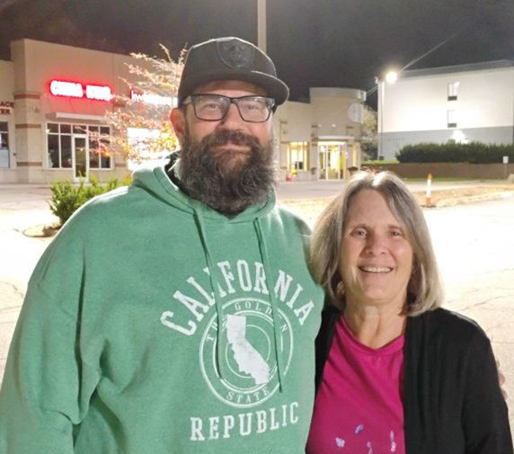
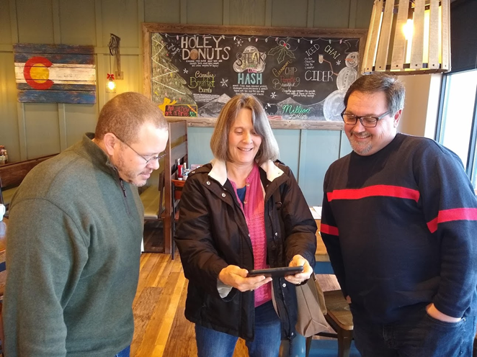
The Empowerment Network
Empowering disciple-makers affected by incarceration
Cathy Allsman
VP Prison Ministry Mobilization
cathy.allsman@completion.global

Slide 12
Questions and Comments

