Slide 1


Discipleship Assessments & Strategies
Angie Bauman, PhD

Slide 2
My assumptions about YOU
YOU …
  are a believer in/follower of Jesus.
  desire to be conformed into Jesus’ likeness/His image.
  strive to obey Jesus.
  bare witness to others the truth of the gospel/Jesus.
  focus on making disciples of Jesus.
  love Jesus by serving justice-involved individuals.

Slide 3
My assumption about MINISTRY
EACH MINISTRY …
  is unique in their role, approach, and context.
  is a recipient of God’s grace.
  is a group of individuals with God-given spiritual gifts.
  has access to God’s wisdom and guidance in the Bible and through the Holy Spirit.

Slide 4
Your Learning Outcomes
You will identify individuals whom you/your ministry serves.
You will gain knowledge about strategy and assessment.
You will assess your current ministry and/or yourself, if you are not engaged with a specific ministry at this time.
You will discuss discipleship strategies and assessments.
You will consider discipleship strategies to serve others.
You will design discipleship assessments to improve you/your ministry effectiveness for the purpose of positively impacting the spiritual growth of the individuals you serve.

Slide 5
DISCIPLESHIP
GOD’S COMMAND
YOUR SERVICE
GOD’S PRESENCE & POWER

Slide 6
Discipleship: God’s Command, Your Service
Disciplemaking includes …
  Going for purposeful engagement
  Baptizing identification with
  Teaching for obedience-sake

Slide 7
Discipleship: God’s Presence & Power
Disciplemaking is empowered by …
  God, Jesus’ Authority
  God, Jesus’ Presence
  God, Holy Spirit’s Indwelling/Power/Work

Slide 8
Common Discipleship Service
Teach God’s Word
Develop Relationships/Community of Faith
Minister to the Needs of Others
Equip/Train Others to Make Disciples

Slide 9
Pause for Engagement
Step 1: Grab a piece of paper or open a document or text screen.
Step 2: Consider the people you/your ministry serve.
Step 3: Jot down a summary description.

Slide 10
WHO? PEOPLE
Describe the typical person you/your ministry serves.
Age groupings
Gender
Spiritual condition – Christians or non-Christians?
Spiritual needs – evangelism, discipleship/Bible, worship, prayer
Felt and Real needs – food, housing, clothing, recovery support, job skills, education, legal services, justice reform, etc.
Developmental needs – physical, emotional, mental, social

Slide 11
ASSESSMENT
GOD ASSESSES
SCRIPTURE ASSESS
YOU ASSESS

Slide 12
GOD ASSESSES
God assesses everything He creates. Genesis 1
  “And God saw that it was good” Genesis 1:4, 10, 12, 18, 21, 25
  God provides His own assessment upon His act of creating. His declaration of “good” represents both the quality and the intention of everything God created.
God assesses His churches. Revelation 1-3
  “Write on a scroll what you see and send it to the seven churches: Ephesus, Smyrna, Pergamum, Thyatira, Sardis, Philadelphia and Laodicea.” Revelation 1:9

Slide 13
SCRIPTURE ASSESS
The Bible/Scripture assesses us.
All Scripture is inspired by God and is useful to teach us what is true and to make us realize what is wrong in our lives. It corrects us when we are wrong and teaches us to do what is right. God uses it to prepare and equip His people to do every good work.
2 Timothy 3:16-17 (NLT)
Aubrey Malphurs, Strategic Disciple Making (Grand Rapids, MI: Baker Books, 2009),107.

Slide 14
YOU ASSESS
You are to assess yourself.
“That is why you should examine yourself before eating the bread or drinking the cup.”
1 Corinthians 11:28 (NLT)
“Each one should test their own actions.”
Galatians 6:3 (NIV)
Aubrey Malphurs, Strategic Disciple Making (Grand Rapids, MI: Baker Books, 2009),107.

Slide 15
Discipleship Assessment Research
Does your church regularly evaluate discipleship progress among your congregation?
  56% - No
  43% - Yes
From LifeWay Research, Transformational Discipleship

Slide 16
Pause for Engagement
Step 1: Grab a piece of paper or open a document or text screen.
Step 2: Consider what you/your ministry does.
Step 3: Jot down a summary description.

Slide 17
WHAT? SERVICE
Describe what you/your ministry does.
Spiritual needs - evangelism, discipleship/Bible, worship, prayer
Felt and Real needs – food, housing, clothing, recovery support, job skills, education, legal services, justice reform, etc.
Developmental needs – physical, emotional, mental, social

Slide 18
DISCIPLESHIP ASSESSMENT
SIGNPOSTS
BIBLE ENGAGEMENT

Slide 19
Signposts of Discipleship
These 8 signposts reveal a person’s spiritual progress:
Engaging the Bible
Obeying God and Denying Self
Serving God and Others
Sharing Christ
Exercising Faith
Seeking God
Building Relationships
Living Unashamed (Transparency)
From LifeWay Research, https://discipleshippathwayassessment.lifeway.com/signposts/

Slide 20
Discipleship Signpost: Engaging the Bible
Research revealed predictors of HIGHER BIBLE ENGAGEMENT scores:
Confessing wrongdoings to God and asking forgiveness.
Believing in Jesus Christ as the only way to heaven and the number of years one has believed this.
Making a decision to obey or follow God with an awareness that choosing to do so might be costly.
Praying for the spiritual status of people they know are not professing Christians.
Reading a book about increasing their spiritual growth.
Having been discipled or mentored one-on-one by a more spiritually mature Christian.
From LifeWay Research, Transformational Discipleship; Discipleship Pathway Assessment

Slide 21
DISCIPLESHIP FOCUS: BIBLE ENGAGEMENT
We believe Jesus transforms lives, and anyone can discover the truth about life, love, themselves, others, and God through the study and application of the Bible.
We believe the Bible reveals truth, making the Bible a source of authority for our lives and a unique resource for us to know God and receive courage for life.
We believe God gives courage by strengthening us with the truth of the Bible and empowering us by the work of the Holy Spirit.

Slide 22
BIBLE RESOURCES
Study Bible for Women
Study Bible for Men
Audio Bible

Slide 23
OBSTABLES TO SPIRITUAL GROWTH
We acknowledge many people have life experiences that create obstacles to embracing the abundant life promised by Jesus in John 10:10. However, life experiences need not define a person’s life but can empower them to become what God intends through faith in Jesus, the study and application of God’s Word, and supportive discipleship.

Slide 24
2024 BIBLE ENGAGEMENT
462,290 tablets in 36 states gave inmates access to 207 teaching videos and audio Bible files from Courage For Life. These videos were viewed 887,390 times and 1,477 inmates indicated they accepted Jesus Christ in 2024 associated with engagement with our audio Bible and our videos.
3,045 Courage For Life Study Bibles given to incarcerated individuals.

Slide 25
SPIRITUAL GROWTH RESOURCES
COURAGE FOR MY LIFE PROGRAM
  Women’s workbooks, English & Spanish
  Women’s video series, English only
  Men’s workbooks, English & Spanish
  Men’s video series, English only

Slide 26
PROGRAM & RESOURCE EFFECTIVENESS
ASSESSMENT OF EMOTIONAL & SPIRITUAL GROWTH
Before beginning the program, each participant completes a pre-questionnaire, which helps us understand their emotional and spiritual state at the outset.
After completing the program, they fill out a post-questionnaire & testimony, which allows us to gauge the program’s impact on their lives and the resource’s effectiveness.

Slide 27
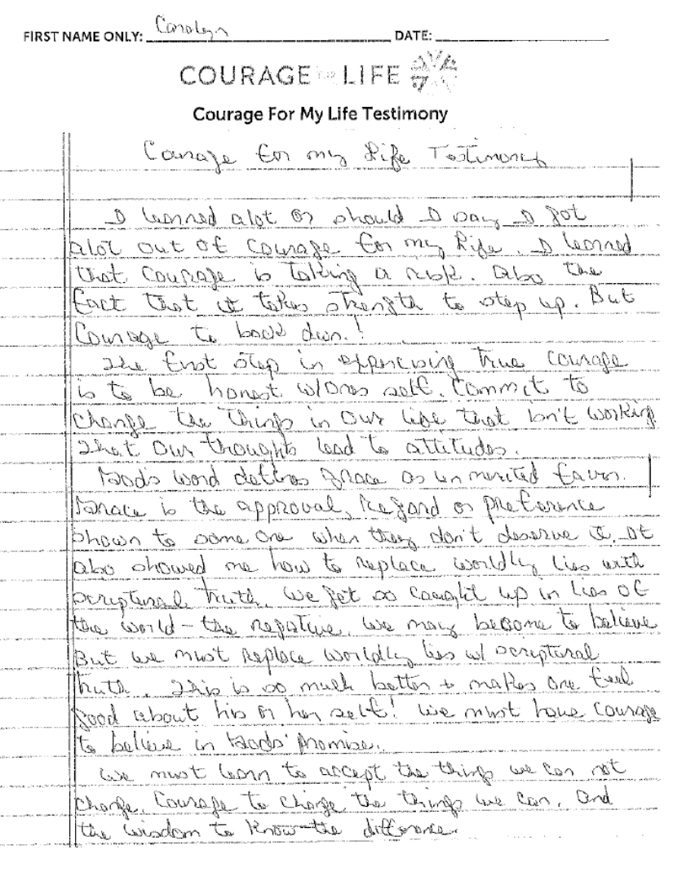

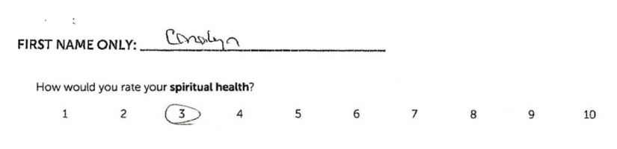
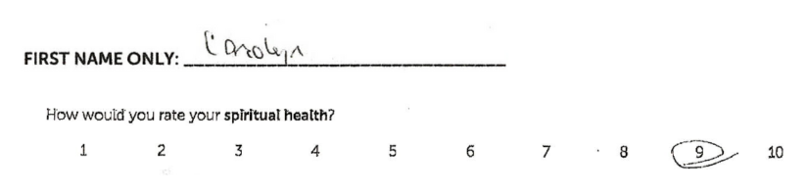
Program Assessment

Slide 28
Program Assessment
"[The Courage For My Life program] showed me that I'm worth so much more than what I thought of myself and that I can overcome anything with God by my side. I now have the courage to face myself and others and be okay with myself because I am a child of God. I can love myself because God loves me." – Maritza, a Courage For My Life program participant at a correctional facility in Idaho
"God has used this course to help unlock hurt and memories that I didn't even know I was holding on to. This journey of healing has drawn me closer to God to help me deal with my childhood abuse that led to my addiction, divorce, and incarceration. Now I have joy, love, and peace from healing that can only come from Jesus. I am free!" – Jake, a Courage For My Life program participant at a correctional facility in Louisiana

Slide 29
Program Assessment
"We have so many men who have tremendously appreciated your men’s study bible with the lion on the cover. The men use these during their study times and several men and women in our facility are voraciously seeking after the living God of His Word." - Kent, correctional facility chaplain in Georgia
January - December 2024, our Courage For My Life program had 985 participants in
70 in-person discipleship classes in 22 facilities in 10 states.
July 2014 – December 2024
24,522 participants (all time)

Slide 30
Pause for Engagement
Step 1: Grab a piece of paper or open a document or text screen.
Step 2: How do you assess what your ministry does?
Step 3: List some ways.

Slide 31
HOW? ASSESSMENT
How do you assess what you/your ministry does.
Assessments
  What assessments correspond to what you/your ministry does?
  Whom do you assess (participants, volunteers, staff)?
Purpose
  Why do you assess the way you do?
  What do you learn through your assessment?
  How is the assessment information used?

Slide 32
PEOPLE – SERVICE – ASSESSMENT
HOW DOES/COULD …
WHO? you/your ministry serves (PEOPLE) inform
WHAT? you/your ministry does (SERVICE) and
HOW? you/your ministry determines its effectiveness (ASSESSMENT).

Slide 33
DISCIPLESHIP ASSESSMENT
STRATEGY: CHRISTIAN MENTORING

Slide 34
EXAMPLE STRATEGY:
CHRISTIAN MENTORING
CHRISTIAN MENTORING is a God-given relationship in which one growing Christian encourages, equips, and empowers another believer in/follower of Jesus to pursue God, and the life God intended for him/her, supporting their spiritual progress/growth.

Slide 35
EXAMPLE STRATEGY:
CHRISTIAN MENTORING
CHRISTIAN MENTORING …
builds on the foundation of Jesus Christ/gospel in another Christian’s life. 1 Corinthians 3:10-15
grows in Christ’s likeness. Ephesians 4:11-13
warns and teaches with godly wisdom. Colossians 1:28-29
is an example worth following. Philippians 3:17
crosses generations, requires self-control, demonstrates spiritual maturity in life, and desires to serve as a role model. Titus 2:1-8

Slide 36
EXAMPLE STRATEGY:
CHRISTIAN MENTORING
WHO? (PEOPLE) = JUSTICE INVOLVED INDIVIDUALS
WHAT? (SERVICE) = DISCIPLESHIP
  (STRATEGY) = CHRISTIAN MENTORING
HOW? (ASSESSMENT) = CHRISTIAN MENTORING EFFECTIVENESS
  Support and assess spiritual progress beyond salvation
  Encourage and assess growth toward Christ’s likeness
  Warn against false/unbiblical beliefs and teach the truth of God’s Word with godly wisdom; assess knowledge of God and God’s Word
  Enlist and equip other Christians who demonstrate spiritual maturity, from different generations, and desire to serve others as Christian role models; assess participants and equipping methods.

Slide 37
CONCLUSION
STRATEGY & ASSESSMENT …
  prioritize quality/standard and intention.
  promote progress.
  support correction.
  encourage appraisal/examination.
  empower preparation/training/equipping.
  should lead to surrender and transformation.
Aubrey Malphurs, Strategic Disciple Making (Grand Rapids, MI: Baker Books, 2009),113.

Slide 38
GOD’S ASSESSMENT
His master replied, ‘Well done, good and faithful servant! You have been faithful with a few things; I will put you in charge of many things. Come and share your master’s happiness!’
Matthew 25:21 (NLT)

Slide 39
Email: contact@courageforlife.org
Phone: (404) 791-7091
Website: https://courageforlife.org
Social: Instagram @GodGivesCourage

Slide 40
Discipleship Assessments & Strategies
Angie Bauman, PhD

